Slide 1

Predictive Learning from Data
LECTURE SET 3
Regularization and
Complexity Control
Electrical and Computer Engineering

Slide 2
OUTLINE
(following Cherkassky and Mulier, 2007 Chapter 3)
Curse of Dimensionality
Function approximation framework
Penalization/ regularization inductive principle
Bias-variance trade-off
Complexity Control
Predictive learning vs. function approximation
Summary

Slide 3

Curse of Dimensionality
Finite high-dimensional data has many counter-intuitive properties
Sample size needed for accurate fct estimation
grows exponentially with dimensionality d

Slide 4
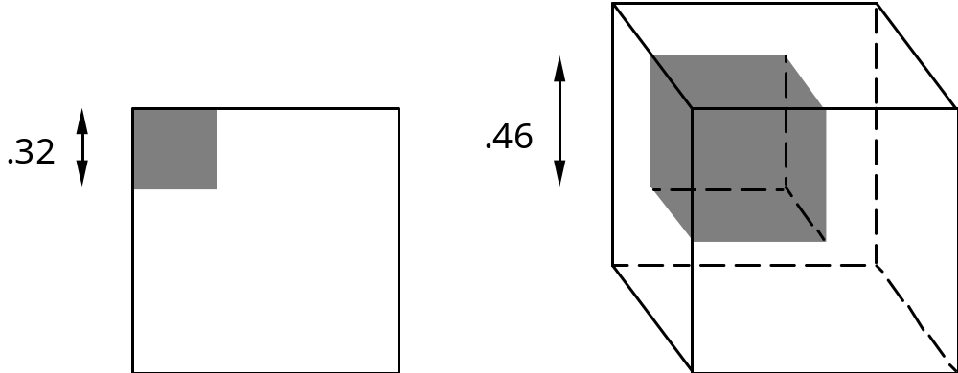
Properties of high-dimensional data:
- almost every point is closer to edge than to another point
- almost every point is an outlier (with respect to all other data samples)
- larger radius needed to enclose a fraction of data points (~10%) → local methods fail in high-dim.

Slide 5
Function Approximation Framework
The Curse: with finite samples learning in high-dimensions is very hard/ impossible ?
BUT
Kolmogorov's theorem states that any continuous function of d arguments can be represented as superposition of univariate functions
→ no curse of dimensionality ???
Explanation: difficulty of learning depends on the complexity of target functions, but Kolmogorov’s theorem does not quantify complexity.
→ Dimensionality is not a good measure of complexity

Slide 6
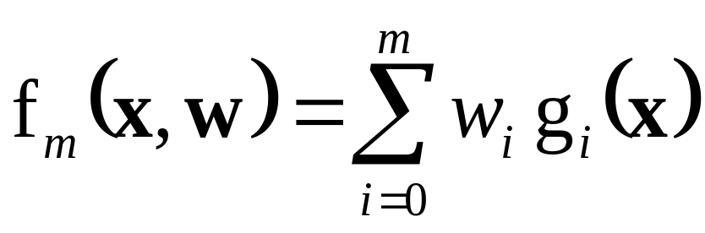
Function Approximation: concepts+results
How to measure function complexity ?
- number of continuous derivatives s
- frequency content (i.e., max frequency)
→ all these measures suffer from the curse of dim.
Central problem in function approximation:
How to represent/approximate any (continuous) target function via given class of basis functions
Example: Weierstrass theorem
Aka dictionary methods

Slide 7
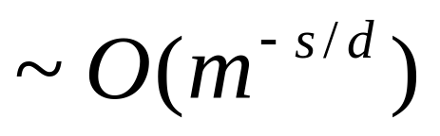
Main Results (1)
Universal Approximation property:
- algebraic polynomials,
- trigonometric polynomials,
- multilayer networks,
- local basis functions (RBF networks) …..
Rate-of-convergence results (asymptotic):
relate the accuracy of approximation to the properties of target function (its dimensionality d and smoothness)
Rate-of-convergence
where s = number of continuous derivatives (~smoothness)

Slide 8
Main Results (2)
Two metrics of function smoothness:
- parametric (~ number of basis functions),
- non-parametric (in frequency domain)
Fundamental restriction:
good function approximation (in high dimension) is possible only for very smooth functions
Implications for machine learning methods:
- good generalization not possible (for high-dim. data),
- need to constrain/control smoothness for multivariate problems → penalization inductive principle.

Slide 9
OUTLINE
Curse of Dimensionality
Function approximation framework
Penalization/ regularization inductive principle
Bias-variance trade-off
Complexity Control
Predictive learning vs. function approximation
Summary

Slide 10
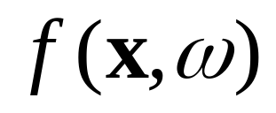
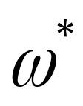
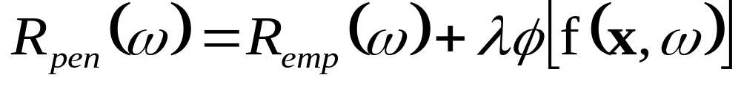
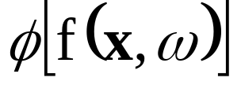


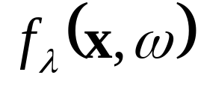
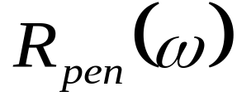
Penalization Inductive Principle
• Specify a wide set of models
Find a model minimizing Penalized Risk
~ non-negative penalty functional; its larger values penalize complex functions.
~ regularization parameter controls the strength of penalty relative to empirical risk (data term)
Model Selection problem: select so that the solution
found by minimizing provides minimum expected risk aka prediction risk aka test error.
→ Need to estimate expected risk for each solution

Slide 11
Modeling Issues for Penalization
• Choice of admissible models
(1) continuous functions
(2) wide class of parametric functions
Type of penalty ~ prior knowledge
(1) nonparametric (smoothness constraints)
(2) parametric, e.g. ridge penalty, subset selection
Method for minimizing
Choice of ~ complexity control
→ Final model depends on all factors above BUT different tradeoffs for small vs. large samples

Slide 12


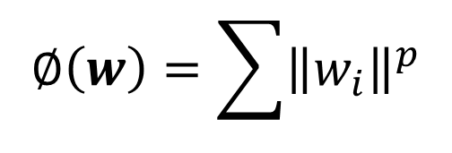
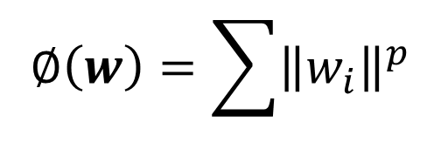
Examples of Parametric Penalties
• Choice of admissible models
Typical penalties on parameters w
- ridge
- bridge for some positive p
- subset selection when p→0

Slide 13
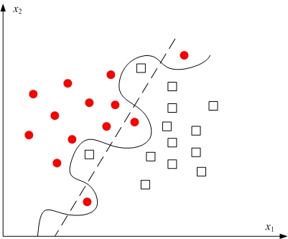
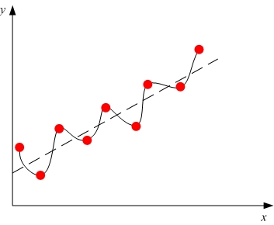
Bias-Variance Trade-Off
Statistical ‘explanation’ for model complexity control
Recall (a) Classification (b) Regression
Imagine many training data sets of the same size

Slide 14
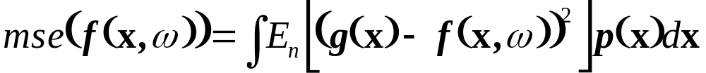
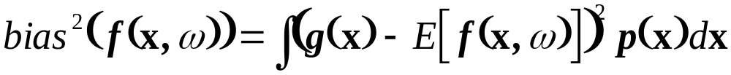
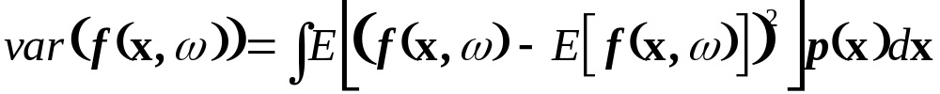
Bias-Variance Trade-Off
For regression problems with squared loss:
Consider MSE btwn an estimate and the target fct. Note: MSE is averaged over many training sets of the same size n
this MSE can be expressed as
where

Slide 15
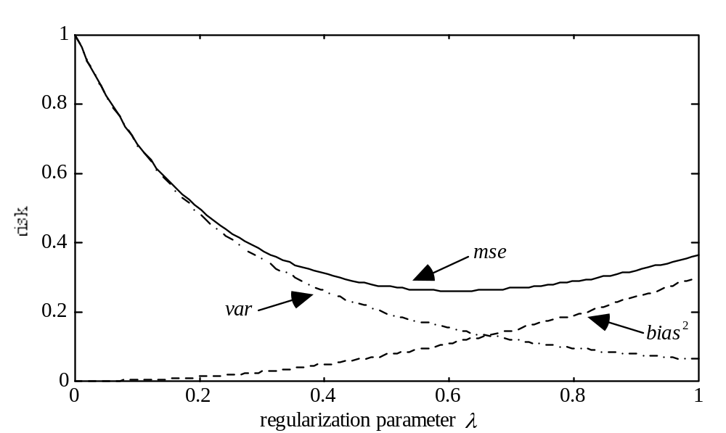
Bias-Variance trade-off and Penalization
Parameter controls bias-variance trade-off:
- larger values → smaller variance/ larger bias
- smaller values → larger variance (the model becomes more dependent on the training data)

Slide 16
Example of Bias-Variance Trade-Off
Consider univariate regression problem where data is generated according to:
with additive Gaussian noise N(0, 0.125)
x-values uniformly distributed in [0,1]
Five training data sets (50 samples each)
Two different estimation procedures used:
- low complexity (too smooth)
- high complexity (not smooth enough)

Slide 17
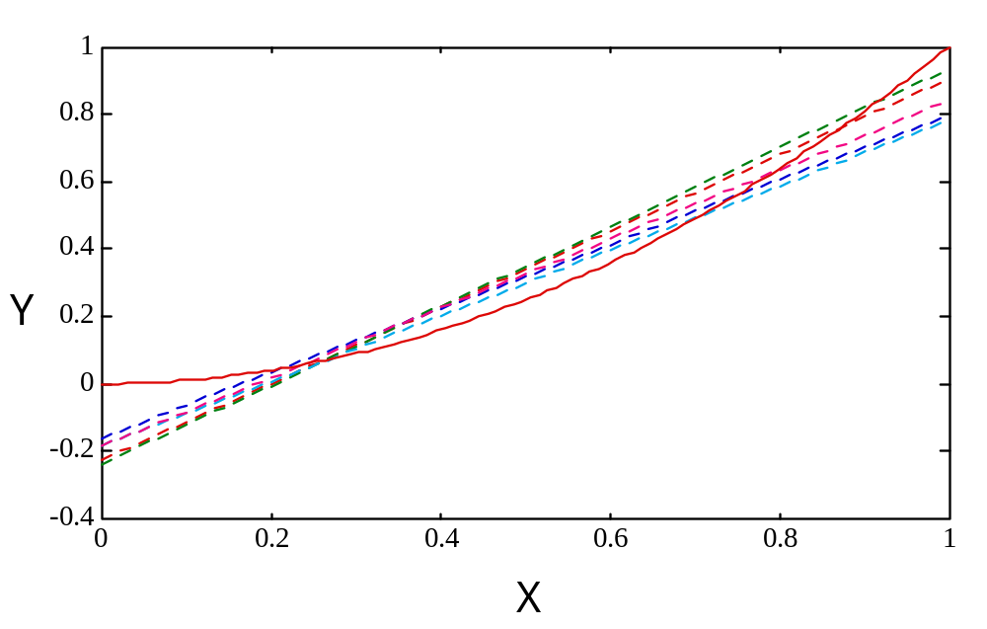
Example of high bias (underfitting)
50 training samples (5 data sets)
Gaussian kernel width ~ 80%

Slide 18
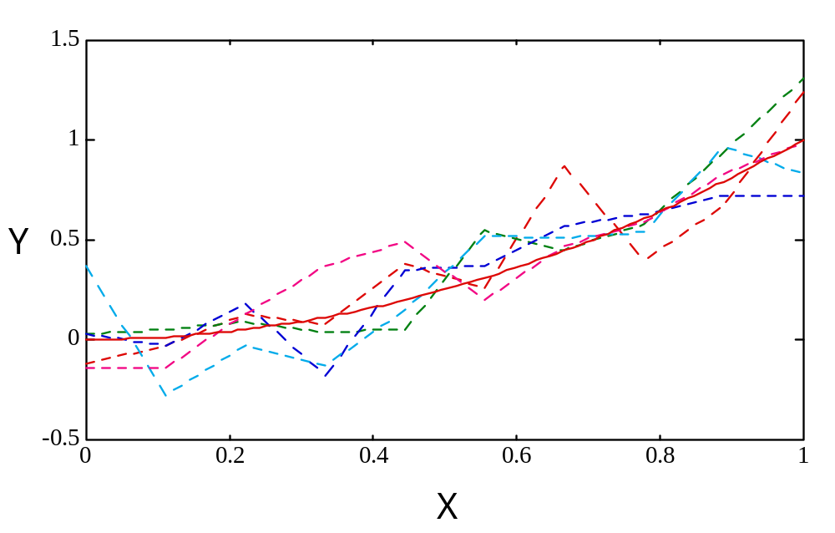
Example of high variance (overfitting)
Same training data (5 data sets)
Piecewise-linear regression fitting (10 components)

Slide 19
Summary: bias-variance trade-off
• Statistical ‘explanation’ for complexity control
• Model estimation depends on two terms:
- data (empirical risk)
- penalization term (~ a priori knowledge)
• A particular set of models (approximating functions) cannot be ‘best’ for all data sets
• Bias-variance formalism does not provide practical analytic model selection

Slide 20
OUTLINE
Curse of Dimensionality
Function approximation framework
Penalization/ regularization inductive principle
Bias-variance trade-off
Complexity Control
Predictive learning vs. function approximation
Summary

Slide 21
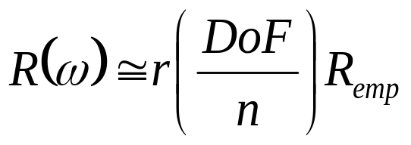
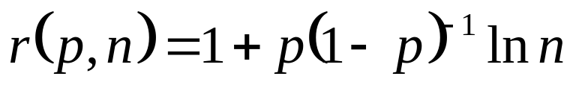
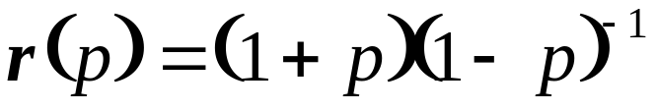
How to Control Model Complexity ?
Two approaches: analytic and resampling
Analytic criteria estimate prediction error as a function of fitting error and model complexity
For regression problems:
Representative analytic criteria for regression
Schwartz Criterion:
Akaike’s FPE:
where p = DoF/n, n~sample size, DoF~degrees-of-freedom
Main Issue: what is DoF ???

Slide 22
Resampling
Split available data into 2 subsets: Training + Validation
(1) Use training set for model estimation (via data fitting)
(2) Use validation data to estimate the prediction error of the model
Change model complexity index and repeat (1) and (2)
Select the final model providing lowest (estimated) prediction error
BUT results are sensitive to data splitting

Slide 23
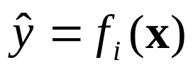
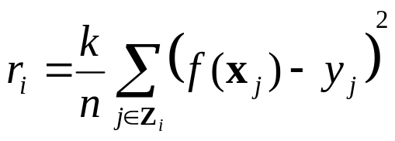
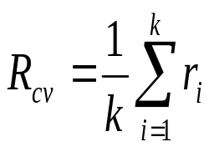
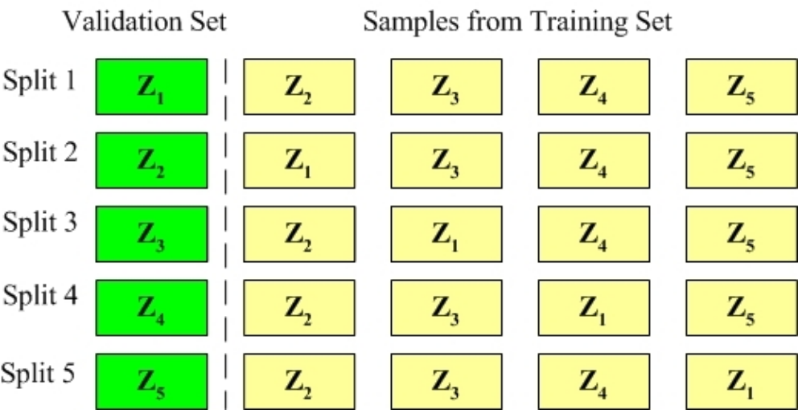
K-fold cross-validation
Divide the training data Z into k (randomly selected) disjoint subsets {Z1, Z2,…, Zk} of size n/k
For each ‘left-out’ validation set Zi :
- use remaining data to estimate the model
- estimate prediction error on Zi :
3. Estimate ave prediction risk as

Slide 24

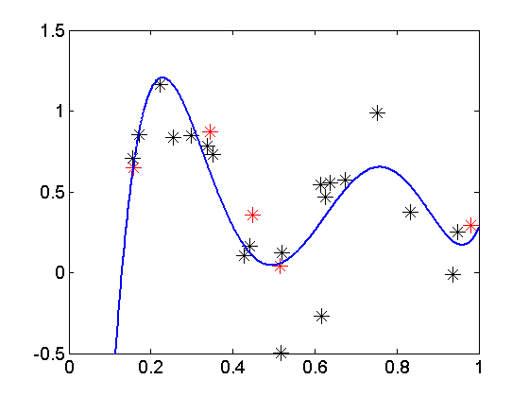
Example of model selection(1)
25 samples are generated as
with x uniformly sampled in [0,1], and noise ~ N(0,1)
Regression estimated using polynomials of degree m=1,2,…,10
Polynomial degree m = 5 is chosen via 5-fold cross-validation. The curve shows the polynomial model, along with training (* ) and validation (*) data points, for one partitioning.
m | Estimated R via Cross validation
1 | 0.1340
2 | 0.1356
3 | 0.1452
4 | 0.1286
5 | 0.0699
6 | 0.1130
7 | 0.1892
8 | 0.3528
9 | 0.3596
10 | 0.4006

Slide 25
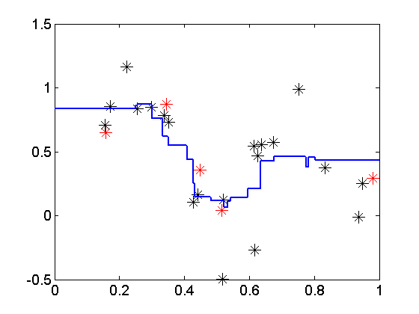
Example of model selection(2)
Same data set, but estimated using k-nn regression.
Optimal value k = 7 chosen according to 5-fold cross-validation model selection. The curve shows the k-nn model, along with training (* ) and validation (*) data points, for one partitioning.
k | Estimated R via Cross validation
1 | 0.1109
2 | 0.0926
3 | 0.0950
4 | 0.1035
5 | 0.1049
6 | 0.0874
7 | 0.0831
8 | 0.0954
9 | 0.1120
10 | 0.1227

Slide 26
More on Resampling
Leave-one-out (LOO) cross-validation
- extreme case of k-fold when k=n (# samples)
- efficient use of data, but requires n estimates
Final (selected) model depends on:
- random data
- random partitioning of the data into K subsets (folds)
→ the same resampling procedure may yield different model selection results
Some applications may use non-random splitting of the data into (training + validation)
Model selection via resampling is based on estimated prediction risk (error).
Does this estimated error measure reflect true prediction accuracy of the final model?

Slide 27
Resampling for estimating true risk
Prediction risk (test error) of a method can be also estimated via resampling
Partition the data into: Training/ validation/ test
Test data should be never used for model estimation
Double resampling method:
- for complexity control
- for estimating prediction performance of a method
Estimation of prediction risk (test error) is critical for comparison of different learning methods

Slide 28

On resampling terminology
Often confusing and inconsistent terminology
- Resampling for model selection:
Double resampling for estimating test error and model selection

Slide 29
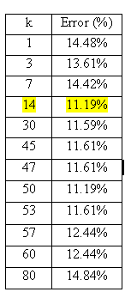
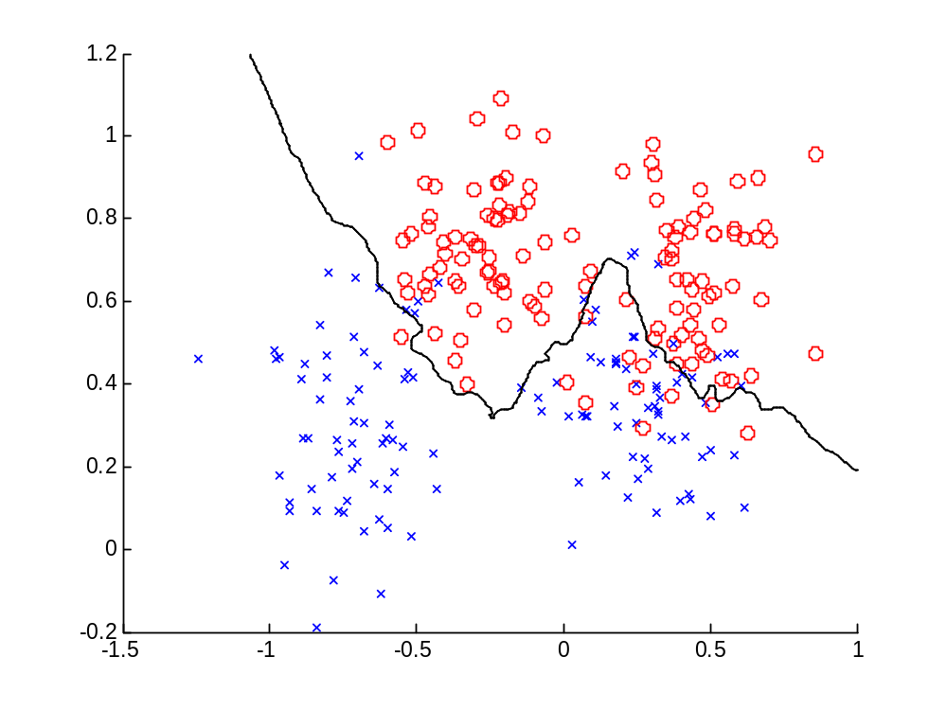
Example of model selection for k-NN classifier via 6-fold x-validation: Ripley’s data.
Optimal decision boundary for k=14

Slide 30
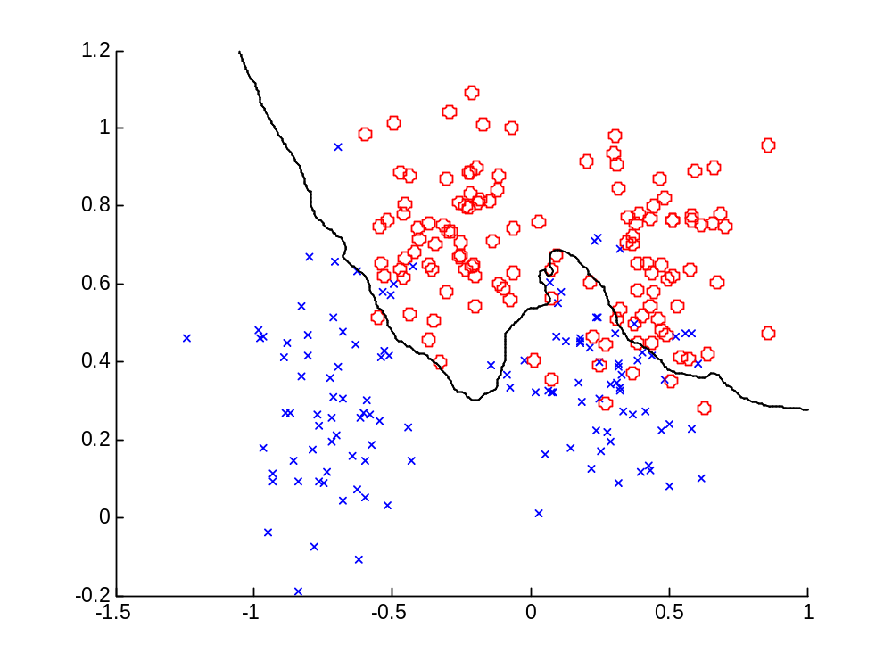
Example of model selection for k-NN classifier via 6-fold x-validation: Ripley’s data.
Optimal decision boundary for k=50
which one
is better?
k=14 or 50

Slide 31
Estimating test error of a method
For the same example (Ripley’s data) what is the true test error of k-NN method ?
Use double resampling, i.e. 5-fold cross validation to estimate test error, and 6-fold cross-validation to estimate optimal k for each training fold:
Fold # k Validation Test error
1 20 11.76% 14%
2 9 0% 8%
3 1 17.65% 10%
4 12 5.88% 18%
5 7 17.65% 14%
mean 10.59% 12.8%
Note: opt k-values are different; errors vary for each fold,
due to high variability of random partitioning of the data

Slide 32
Estimating test error of a method
Another realization of double resampling, i.e. 5-fold cross validation to estimate test error, and 6-fold cross-validation to estimate optimal k for each training fold:
Fold # k Validation Test error
1 7 14.71% 14%
2 31 8.82% 14%
3 25 11.76% 10%
4 1 14.71% 18%
5 62 11.76% 4%
mean 12.35% 12%
Note: predicted average test error (12.8%) is usually higher than minimized validation error (10.6%) for model selection, as shown in the first realization

Slide 33
OUTLINE
Curse of Dimensionality
Function approximation framework
Penalization/ regularization inductive principle
Bias-variance trade-off
Complexity Control
Predictive learning vs. function approximation
Summary

Slide 34
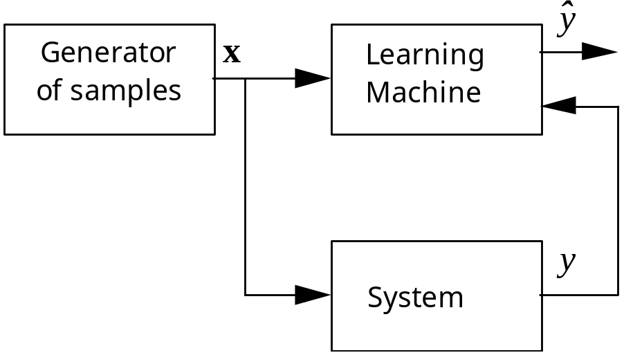

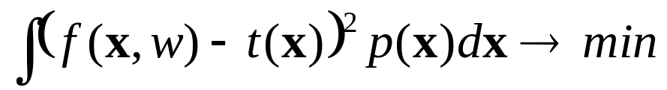
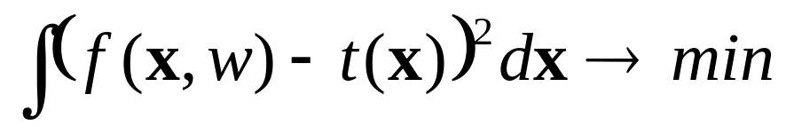
Inductive Learning Setting
Consider regression problem
Goal of Predictive Learning:
Goal of function approximation (system identification):

Slide 35
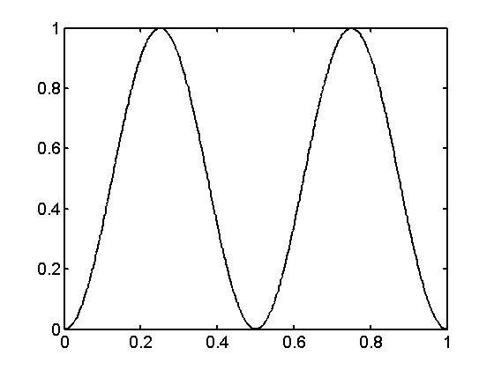
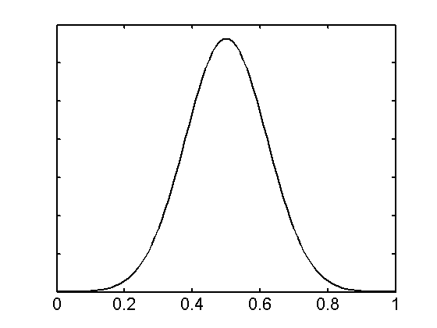
Example from [Cherkassky & Mulier, 2007, Ch. 3]
Regression estimation: penalized polynomials of degree 15);
30 training samples / 30 validation samples (for tuning lambda)
Target function
Distribution of x (training data)

Slide 36
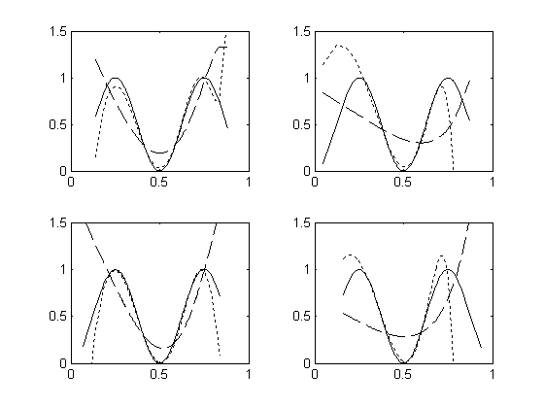
Typical Results/ comparisons for
Predictive setting: validation data ~ normal distribution
Function approximation: validation ~ uniform distribution in [0,1]
Dotted line ~ predictive setting / Dashed ~ fct approximation

Slide 37
Conclusion
The goal of predictive learning is different from function approximation ~ accurate estimation everywhere in the input domain.
The goal of predictive learning is less demanding
The curse of dimensionality applies for fct approximation setting, but not to predictive setting
Both settings are equivalent for uniform input distribution, i.e. in signal processing applications

Slide 38
Summary
Regularization/ Penalization ~ provides good math framework for predictive learning
Important distinction:
predictive learning vs. system identification
Bias-variance trade-off
Complexity control and resampling
- analytic criteria (typically for regression only);
- resampling methods (may have high variability)

